Slide 1
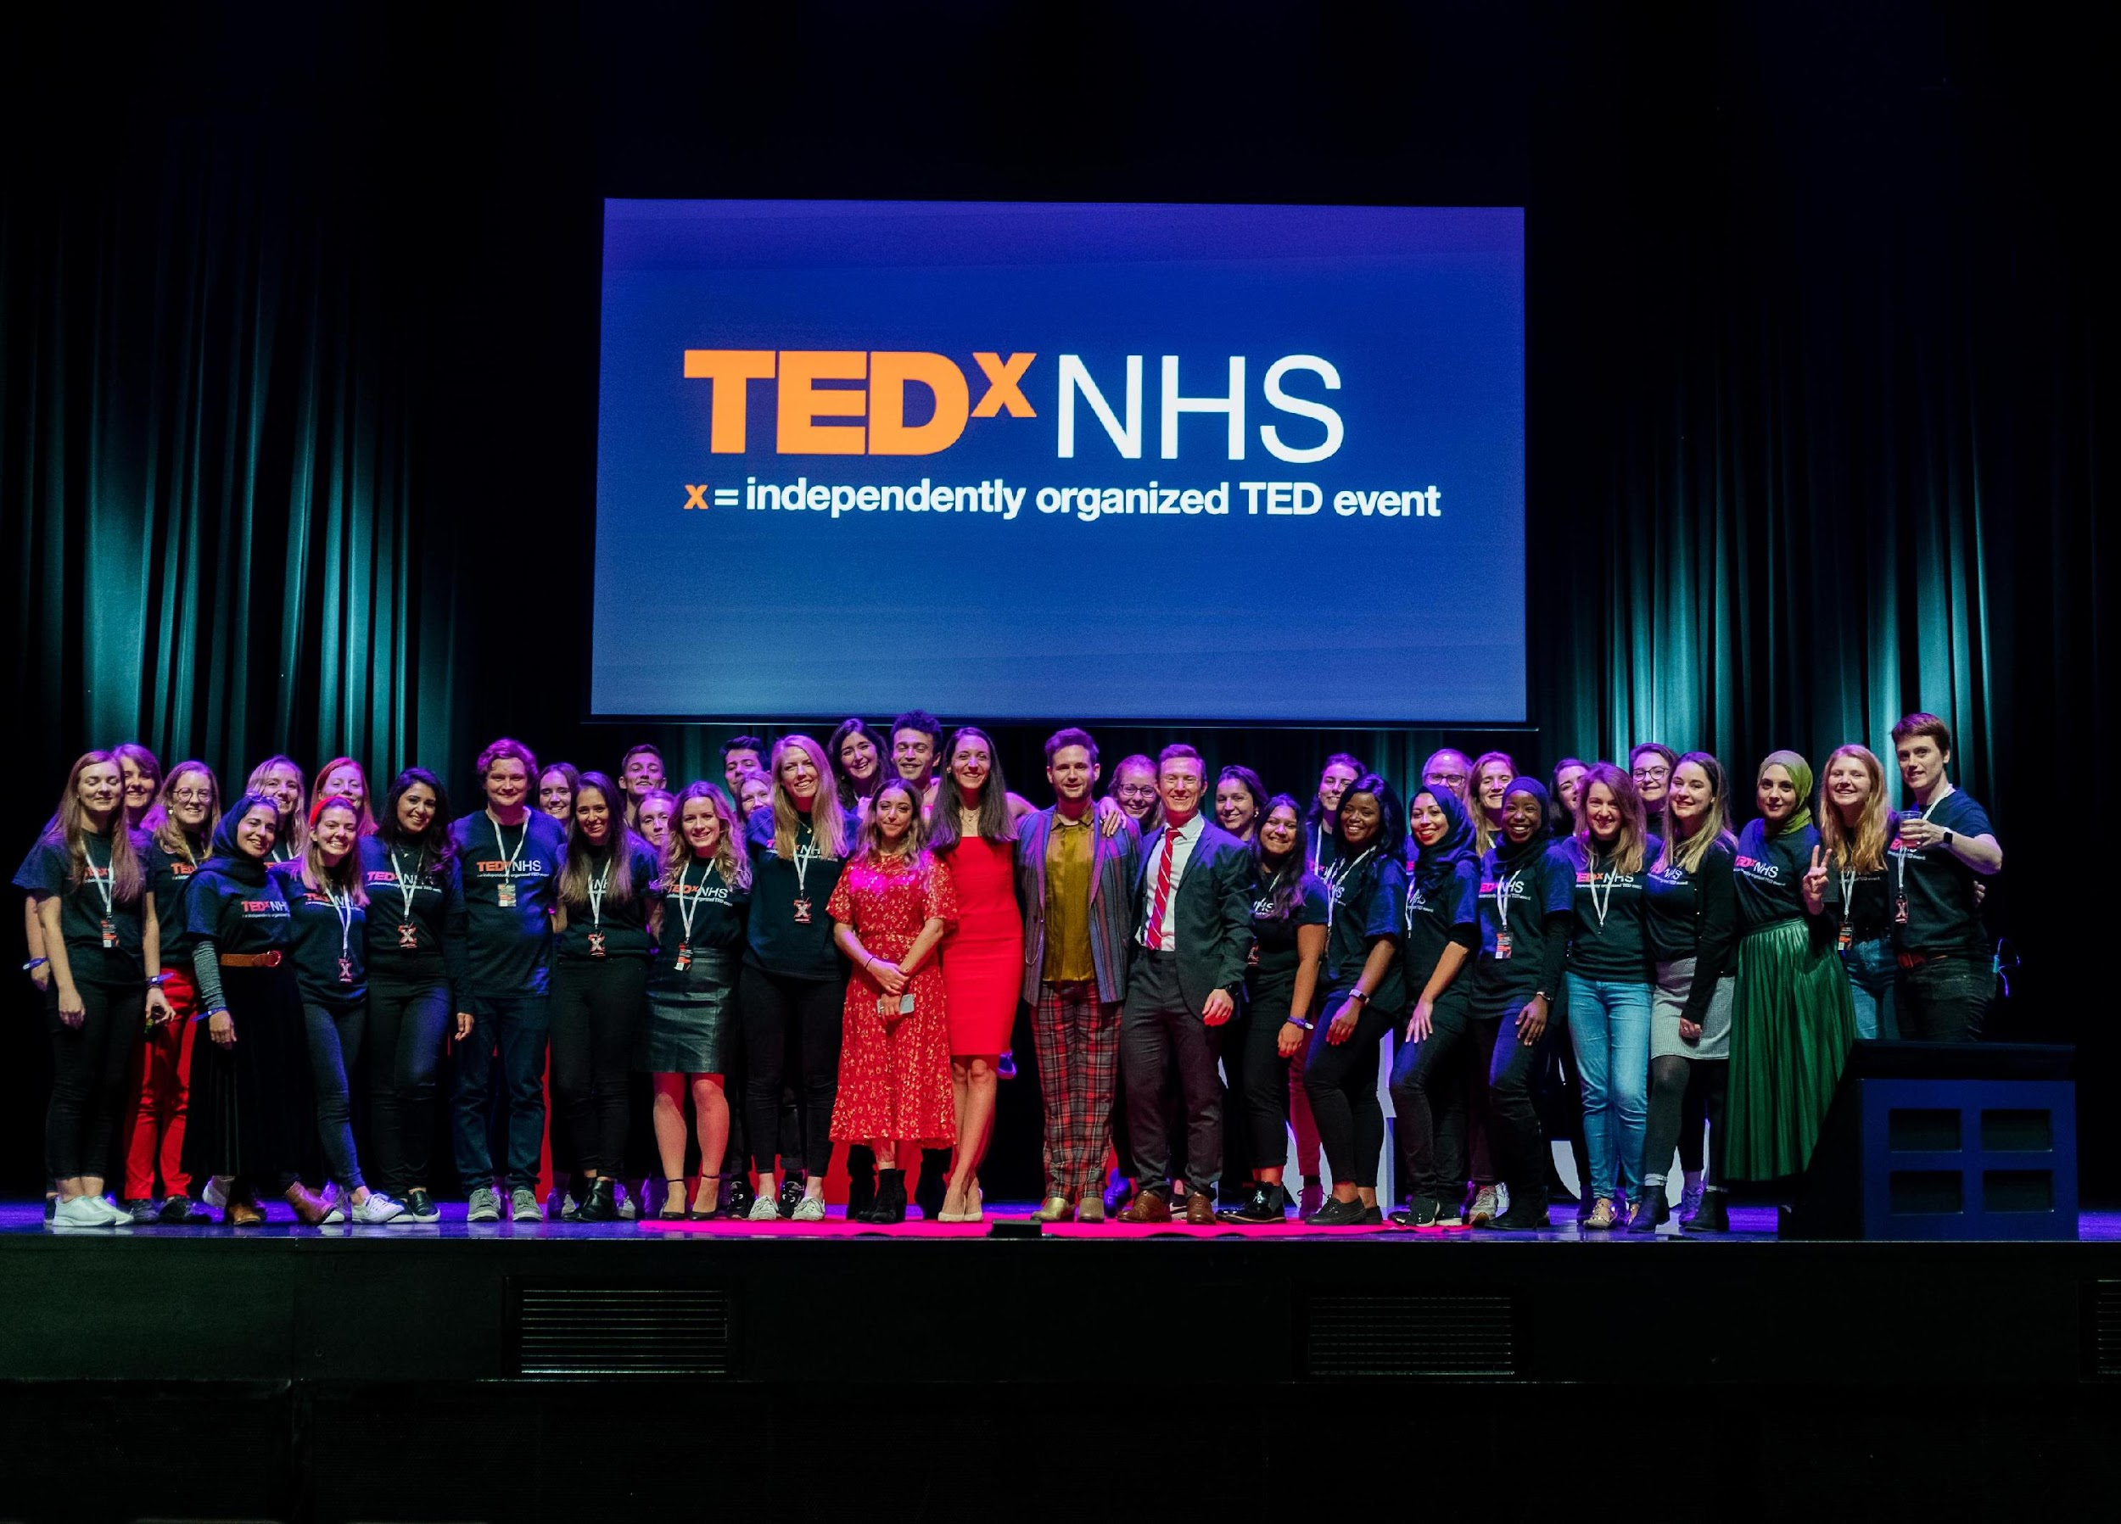
TEDxNHS Partnership

Slide 2

TED is ideas change everything
TEDxNHS is an independently organised TED event for the NHS, by the NHS. We represent the 1.5 million people who work for the NHS and produce talks which challenge, celebrate and unite us to improve the health of the nation.
Every year volunteers from across the NHS produce our TEDxNHS annual event showcasing a series of brand new TEDx talks. We are grateful to our partners who enable us to meet our event and production costs allowing us to continue creating high quality TEDx talks using storytelling for change.

Slide 3



The TEDxNHS Mission
To create a platform for untold stories
To spread innovation in the NHS
To develop future leaders

Slide 4

Our Reach
58 talks published onto TEDx YouTube channel with 39.7m subscribers
10 TEDxNHS events
Millions of YouTube views
2500 in person attendances at TEDxNHS events
Awarded ‘Legacy License’ status from TED
The only TEDx team which represents the NHS
+100 leaders developed through participation in the TEDxNHS Team
Long standing partnerships developed with our partners

Slide 5
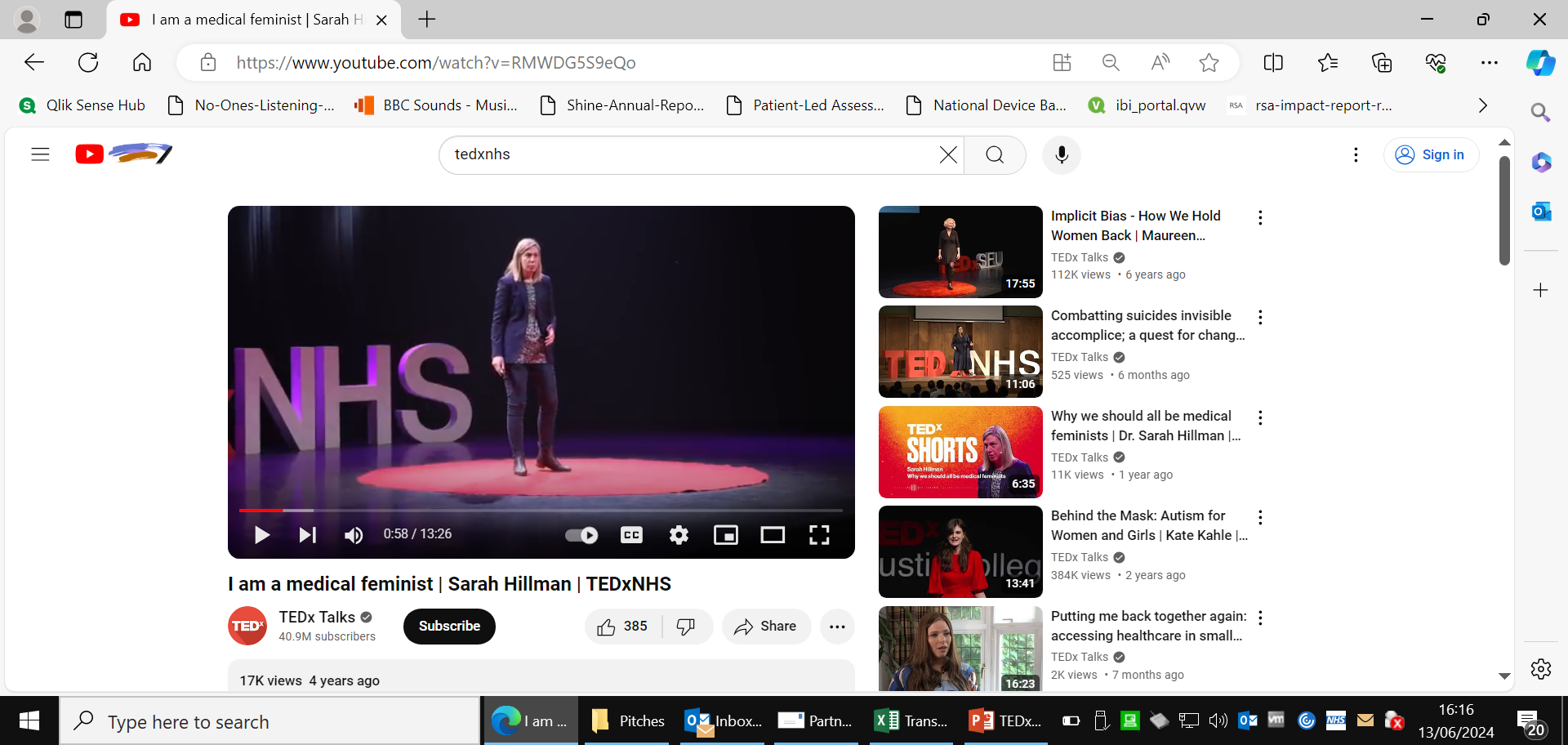
Speaker Impact
Initiation of the Lived Experience Charter, now live in >50 NHS organisations and launch of RECONNECT, a brand new, National care after custody service
Recognition of achievement including from Michelle Obama who wrote to Khadija Owusu (2022) “I saw your TEDx Talk, and I just wanted you to know how proud I am of you.”
Our speakers have gone on to shape National policy. Charlie Webster (2019) consulted on the government’s Violence Against Women and Girls Strategy
Yvonne Newbold (2022) told us “I’ve had messages and emails from all around the world from people who have seen it, telling me how it’s changed the way they practice, or it’s changed the way they are parenting. It’s so heart warming to know what a difference this is potentially making to children everywhere, and that’s all down to you and your team taking a chance and believing in me.”
Many of our speakers have gone on to publish books following their TEDxNHS talks:
        Dr Waheed Arian (2016) In the Wars (penguin.co.uk)
        Rama Gheerawo (2017) Creative Leadership (penguin.co.uk)
        Charlie Webster (2019) Why It's OK to Talk About Trauma by Charlie Webster | Hachette UK
        Rachel Clarke (2021) Dear Life by Rachel Clarke | Hachette UK
        Emma Short (2023) Healthy Gut, Happy You | The Book Guild Ltd

Slide 6
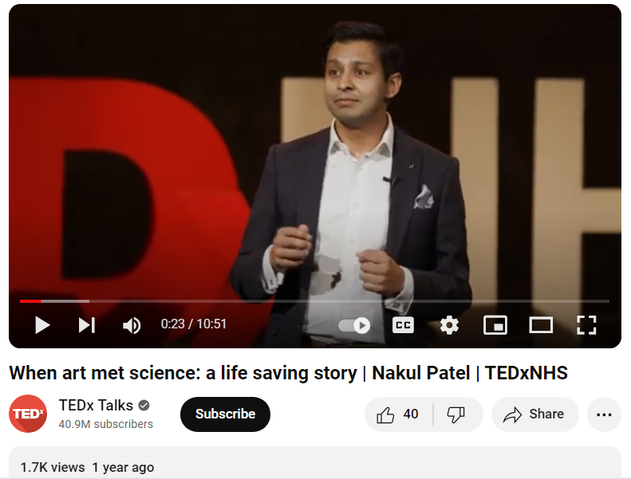
Partner Impact
Partners tell us that TEDxNHS refocuses their teams on what really matters. It gives their colleagues renewed energy at work and is the most valuable collaboration they hold in terms of impact and network.
Partners have had the opportunity to connect with the TEDxNHS network through meaningful introductions which we facilitated. There are further opportunities to collaborate through our broader NHS and TEDx networks.
Brand recognition as TEDxNHS carries the names of both TEDx and the NHS in its name. Partners will be celebrated in our online content (website and social media), at our events, and on the sponsor slide on TEDxNHS talks which are published on the TEDx YouTube channel. Partners are also welcome to share our partnership in their own marketing materials.

Slide 7

Partnership options
Partnership Benefits
Basic Partnership £10k
Tickets to attend TEDxNHS
Partner branding featured on TEDxNHS YouTube videos and online content and permission to use TEDxNHS branding on your own materials
Standard Partnership £15k
Exhibition space at TEDxNHS 2025.
Become part of the TEDxNHS family including NHS leaders, innovators, TEDxNHS alumni, partners and the wider TEDx community. As a partner you will be invited to smaller, more intimate events and we will be happy to make meaningful introductions across our network.
Partnership Plus £20k
Host the TEDxNHS event drinks reception or pre-event dinner.
Co-brand TEDxNHS merchandise e.g. notebook or bottle
10% discount available for multi year commitment

